Slide 1
INDIA TRAVEL GUIDE

Slide 2
ACKNOWLEDGEMENT “We would like to express our special thanks of gratitude to our teacher Er. Rahul Aggarwal who gave us the golden opportunity to do this C++ project on topic Travel and Tourism which helped us a lot in learning many new things. It helped to increase our Knowledge and Skills and we learned team-work.”

Slide 3
TABLE OF CONTENTS
01
ABOUT THE CITIES
03
DISCOUNT SCHEMES
02
TRANSPORT
04
BILLING

Slide 4
WHOA!WELCOME TRAVELLER

Slide 5
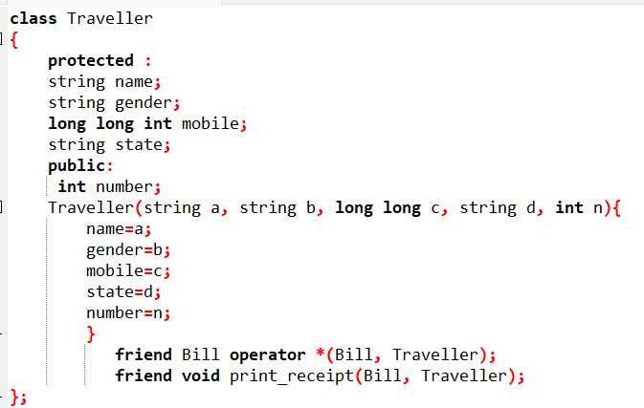
Traveller Class
It’s the class that stores the personal details of the passenger like his/her name, gender, mobile number, state from where he/she belongs, number of travellers travelling.
We have used Traveller constructor that will store
the personal data of the traveller(s).

Slide 6
01
ABOUT THE CITIES
1. GOA 2. AGRA 3. RAJASTHAN 4. DELHI 5. COORG 6. KULLU MANALI 7. LEH LADAKH 8. KERELA 9. MCLEODGANJ 10. LAKSHADWEEP

Slide 7
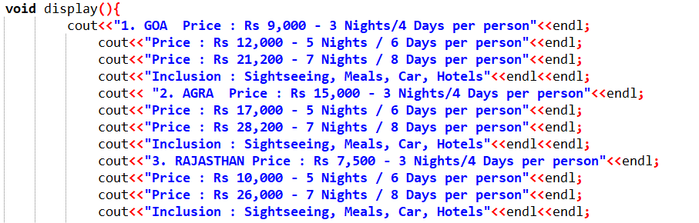
Destination Class
This is the second class that we used.
This class contains the list of available locations for the users to visit.
This class also gives you the options to decide the number of days you wish to stay in hotels.

Slide 8
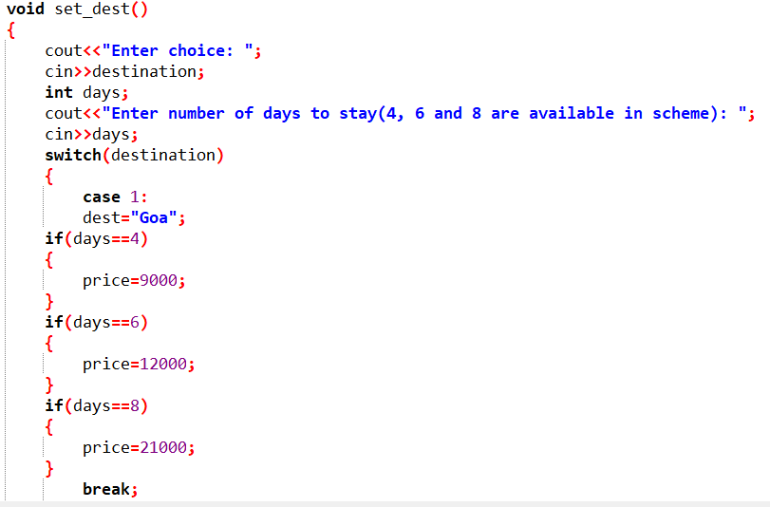
FUNCTIONS INVOLVED IN DESTINATION CLASS :
1. void display()
This function displays the list of available options for the user to book hotels
2. void set_dest()
This function displays the user a list of options to chose
hotels in their preferred city according their own choice
of days of stay .

Slide 9
TRANSPORT CLASS
1. FLIGHT
3. BUS
2. TRAIN
02
This class is publicly inherited from its parent class i.e. destination.
It contains the list and cost of different means of travel available such as flights, buses and trains.

Slide 10
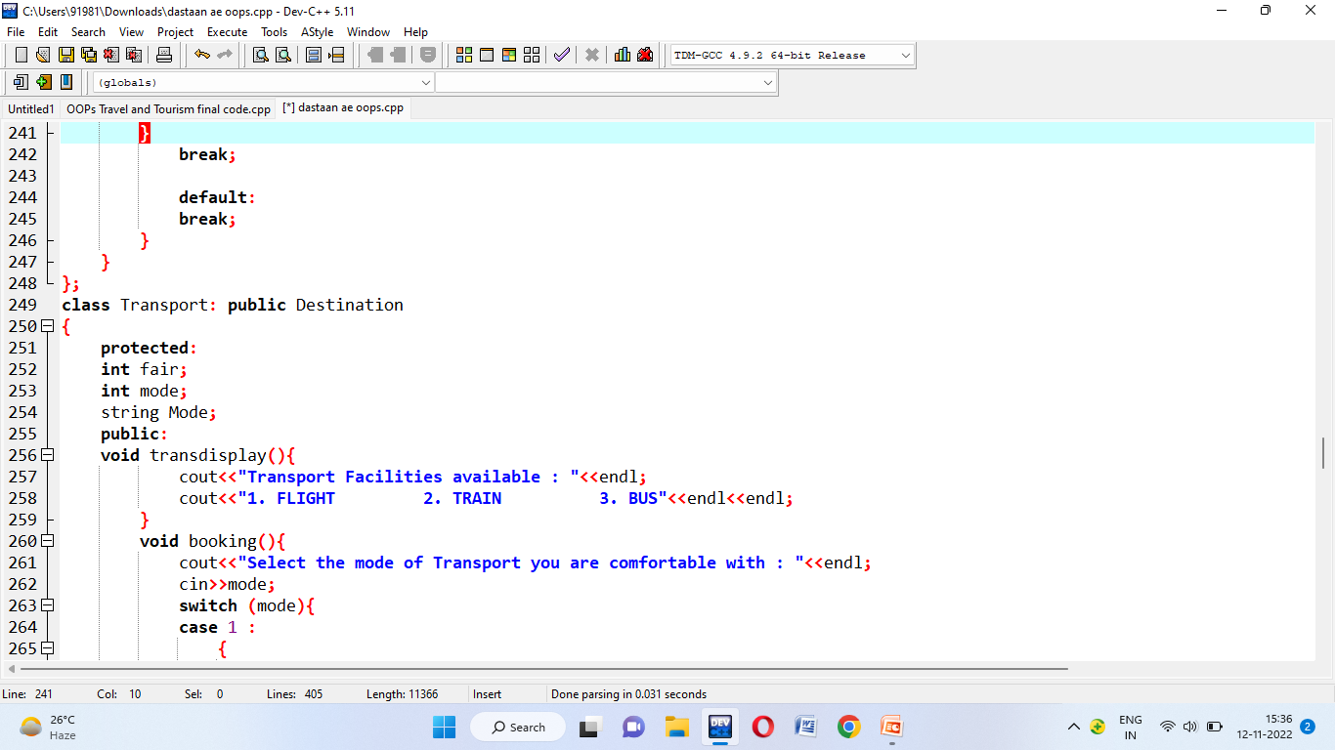
FUNCTIONS INVOLVED IN TRANSPORT CLASS :
1. void transdisplay()
This function displays the transport facilities available.
2.void booking()
This function helps the user to select the means of transport according to his/her preference.

Slide 11
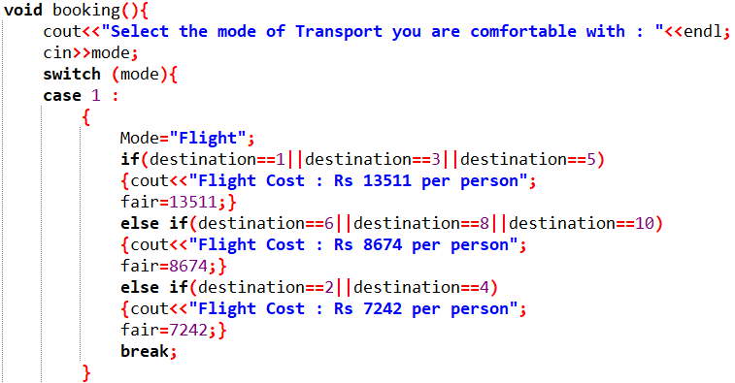

Slide 12
DISCOUNT CLASS This class is publicly inherited from its parent class i.e. Transport class. This class is used to give discount offers to the user.
03
10%
FAMILY DISCOUNT
15%
1ST BOOKING
07%
ALONG SPOUSE
11%
DIWALI SCHEME

Slide 13
FUNCTIONS INVOLVED IN DISCOUNT CLASS : 1. void show schemes() This function displays the different schemes of discount available for the user. 2. void add_scheme() This function adds the discount option selected by the user in their final b

Slide 14
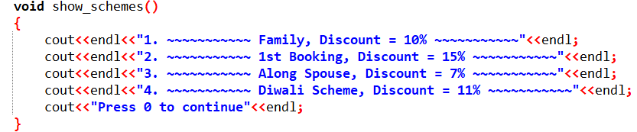
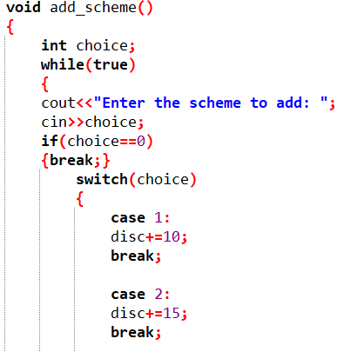
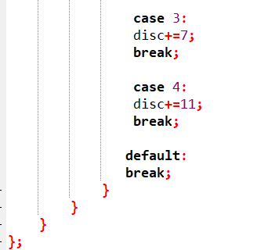

Slide 15
BILL CLASS This class is publicly inherited from its parent class i.e. discount class. This class is used to display the total amount of bill of the user after the booking is done. FRIEND FUNCTION-A friend function is a function that isn't a member of a class but has access to the class's private and protected members.
04
DESTINATION | DAYS | TRANSPORT | COST
Lakshadweep | 6 Days | By Flight | Rs. 93,035
Goa | 8 Days | By Train | Rs. 79,016
Delhi | 4 Days | By Bus | Rs. 17,642
Coorg | 6 Days | By Train | Rs. 59,382

Slide 16
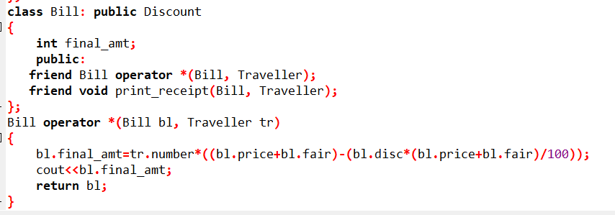
. OPERATOR OVERLOADING It is a specific case of polymorphism, where different operators have different implementations depending on their arguments

Slide 17
Main Function
The main function is called at program startup after initialization of the non-local objects with static storage duration.
It is the designated entry point to a program that is executed in hosted environment (that is, with an operating system).

Slide 18
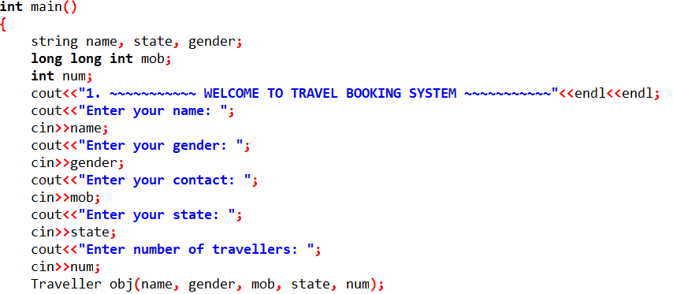
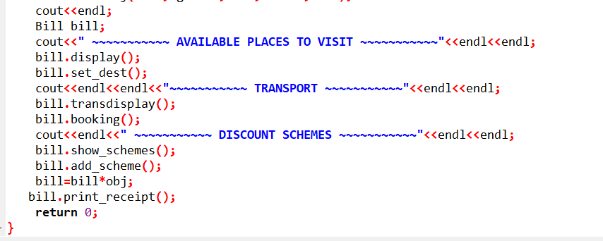

Slide 19
OUR TEAM
ALISHA RNO : 21103009
ALOK KR. VERMA RNO : 21103010
ARPIT SALARIA
RNO : 21103025

Slide 20
THANKS!

